Slide 1
Blind stick obstacle sensor
Name of Team members:
1.Pranav AvAsare A-19
2.Sandhya khomane A-03
3.Akshada khatale A-20
4.Grishma dalvi A-15
5.Atharv kurve A-18

Slide 2
Introduction:
The purpose of the blind stick obstacle sensor project is to assist visually impaired individuals in navigating their surroundings safely by detecting obstacles. Designing an effective and reliable system that accurately detects obstacles in various environments and conditions, while also being user-friendly and portable, presents several challenges that need to be addressed during the development process. obstacles in their path and providing feedback to the user.
This project can significantly enhance the independence and safety of visually impaired individuals by providing them with real-time information about their surroundings, helping them navigate with greater confidence and ease.

Slide 3
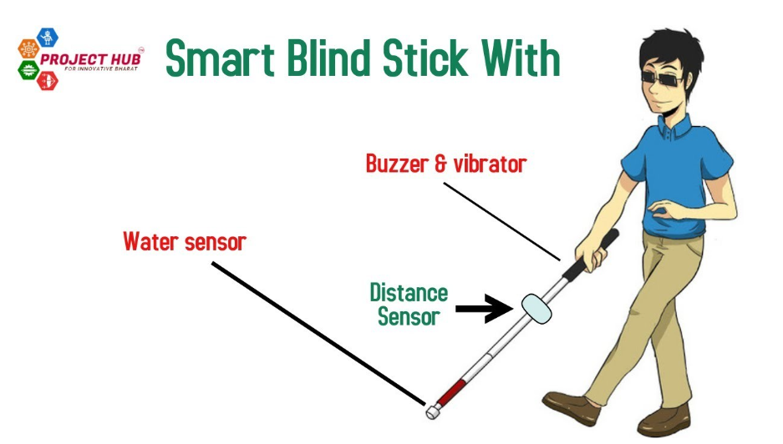
Components:
Sensors used:
Ultrasonic sensor
Buzzer
Microcontroller used:
Arduino Uno board
Battery used:
Lithium batteries
Other components used:
jumper wires
Switch
Pvc pipe used as stick
LED (220 ohm)

Slide 4
Ultrasonic Sensors:
These sensors emit ultrasonic waves and measure the time it takes for the waves to bounce back, allowing the device to detect obstacles in the vicinity.
Buzzer:
Sound feedback can provide information about the proximity and direction of obstacles. A buzzer or a small speaker can emit different tones or patterns to indicate varying distances.
Microcontroller:
A microcontroller serves as the brain of the system, processing data from the sensors and controlling the feedback mechanism. Popular choices include Arduino boards (such as Arduino Uno or Arduino Nano) or Raspberry Pi.

Slide 5
Battery used:
A rechargeable battery powers the blind stick for portability. The choice of battery depends on factors such as the power requirements of the components and the desired runtime.we have used lithium battery
Jumper wires:
Jumper wires are an essential component in electronics prototyping and projects like the blind stick obstacle sensor project.
Switch and Led:
Power On/Off: A switch can be used to control the power supply to the entire system, allowing the user to turn the blind stick on or off as needed.
LEDs can be used as visual indicators to provide feedback to the user about the status or operation of the device

Slide 6
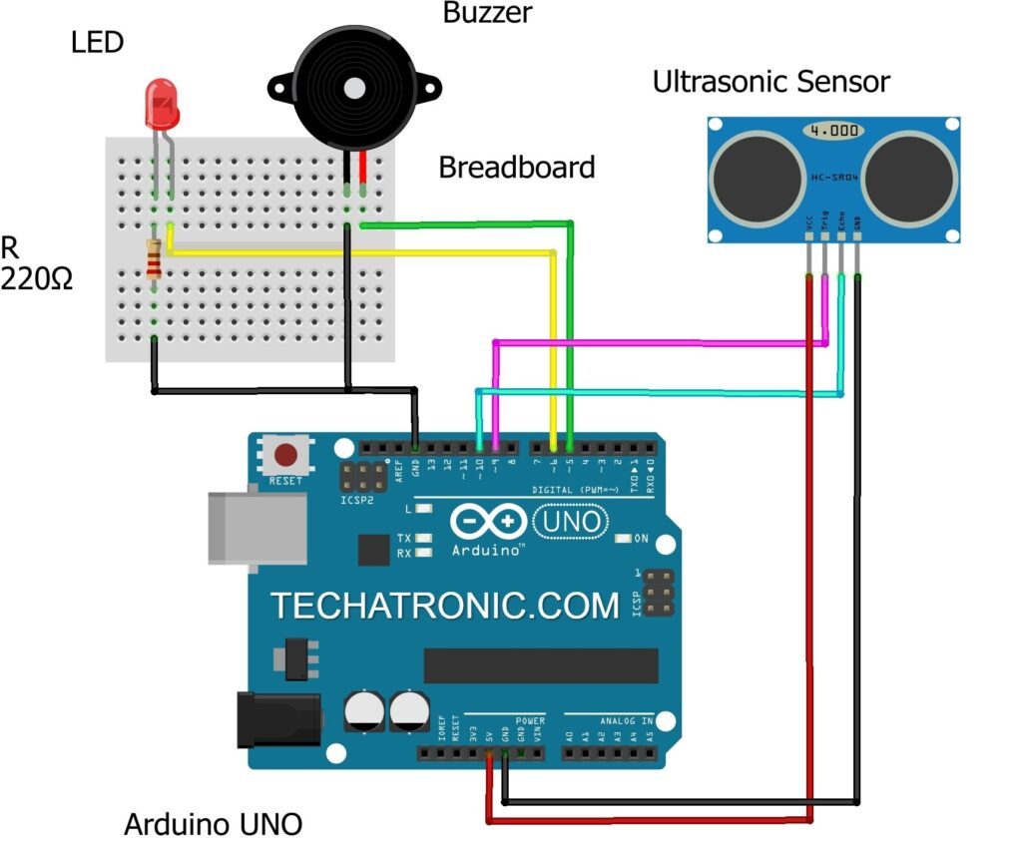
Circuit diagram:

Slide 7
Working:
The Smart Blind Stick scans the path in front of it with the help of an HC-SR04 Ultrasonic sensor.
Whenever the sensor detects any object in its path the buzzer starts beeping and also at the same time the LED turns on.
The blind person can hear the beeping of the buzzer and manage to change the way. In this way, the person can easily find his way without getting injured.
This smart stick works in the same way as the Ultrasonic range finder did. You can also see the real-time values of the distance in cm on the Arduino serial monitor.
Once the circuit is ready for this Arduino mini-project tie the whole set-up to a stick using zip ties.

Slide 8
Benefits:
Enhanced Safety: The primary benefit of a smart blind stick is enhanced safety for visually impaired individuals. By detecting obstacles in their path, the stick can alert users to potential hazards, reducing the risk of accidents and injuries.
Increased Independence: With the assistance of the smart blind stick, visually impaired individuals can navigate their surroundings with greater independence. They can confidently move around without constantly relying on assistance from others.
Customizable Design: The Arduino platform allows for flexibility and customization. Users can tailor the smart blind stick to their specific needs and preferences by adjusting parameters such as detection range, sensitivity, and feedback mechanisms.

Slide 9
Real-time Feedback: The integration of LED lights and a buzzer provides real-time feedback to the user about the proximity of obstacles. This immediate feedback allows users to react quickly and make necessary adjustments to avoid collisions.
Low Cost: Arduino microcontrollers and components like ultrasonic sensors, LEDs, and buzzers are relatively affordable, making the smart blind stick an accessible solution for individuals with limited resources
Educational Opportunity: Building a smart blind stick with Arduino is not only practical but also educational. It provides an opportunity for individuals to learn about electronics, programming, and assistive technology while working on a meaningful project.

Slide 10
Model demonstration:

Slide 11
Challenges:
Developing a blind stick obstacle sensor project presents several challenges that need to be addressed to create a functional and effective solution for visually impaired individuals. Here are some common challenges:
Accuracy of Obstacle Detection: Ensuring that the sensors accurately detect obstacles in the environment is crucial for the safety of the user. Challenges may arise due to varying object shapes, sizes, and materials, as well as environmental factors such as lighting conditions and acoustic interference.
Distance Measurement: Obtaining accurate distance measurements to detected obstacles is essential for providing timely feedback to the user. Challenges may include calibration issues, signal interference, and limitations of the sensor technology.

Slide 12
Portability and Durability: The blind stick device needs to be portable, lightweight, and durable to withstand daily use by visually impaired individuals. Challenges include optimizing the size and weight of the device while ensuring robustness and reliability.
Power Management: Maximizing battery life and optimizing power consumption are critical for ensuring the device's usability and reliability. Challenges may include selecting efficient components, implementing power-saving features, and managing power fluctuations during operation.
User Testing and Feedback: Conducting thorough user testing with visually impaired individuals is essential for evaluating the effectiveness and usability of the device. Challenges may include recruiting participants, gathering feedback, and incorporating user preferences and suggestions into the design

Slide 13
Future improvements:
Advanced Obstacle Detection Algorithms: Explore advanced signal processing techniques and machine learning algorithms to improve the accuracy and reliability of obstacle detection. This could involve incorporating depth sensing technologies such as LiDAR or stereo vision for better spatial awareness.
Integration with Smart Devices: Integrate the blind stick with smartphones or wearable devices to provide additional functionalities such as navigation assistance, voice commands, and remote monitoring. This could leverage the capabilities of existing accessibility features and assistive technology platforms.
Multi-Sensor Fusion: Combine data from multiple sensors, such as ultrasonic, infrared, and thermal sensors, to enhance the robustness and versatility of obstacle detection in various environments and conditions.

Slide 14
Haptic Feedback Enhancements: Explore innovative haptic feedback mechanisms, such as tactile arrays or shape-changing materials, to provide more intuitive and immersive feedback to the user. This could improve spatial awareness and reduce cognitive load.
Customizable User Profiles: Implement customizable user profiles that allow users to adjust settings and preferences according to their individual needs and preferences. This could include personalized feedback patterns, sensitivity levels, and audiovisual cues.
Localization and Mapping: Incorporate localization and mapping capabilities to help users navigate unfamiliar environments more effectively. This could involve creating digital maps of indoor spaces and integrating positioning technologies such as GPS or indoor positioning systems (IPS).

Slide 15
Conclusion :
In conclusion, the blind stick obstacle sensor project holds significant potential to enhance the mobility, safety, and independence of visually impaired individuals. By leveraging sensor technology, microcontrollers, and feedback mechanisms, this project aims to provide real-time detection and notification of obstacles in the user's path. Despite challenges such as accuracy, usability, and power management, advancements in signal processing, user interface design, and collaborative development offer promising opportunities for improvement.

Slide 16
THANK YOU!!

